Slide 1


Pricing & Room Type Analysis of Airbnb: Chicago vs New Orleans
Analysis of 6,542 Airbnb listings across Chicago (60.4%) and New Orleans (39.6%), examining pricing trends, room types, and guest experiences.
by Rakhi Chakrabarty

Slide 2
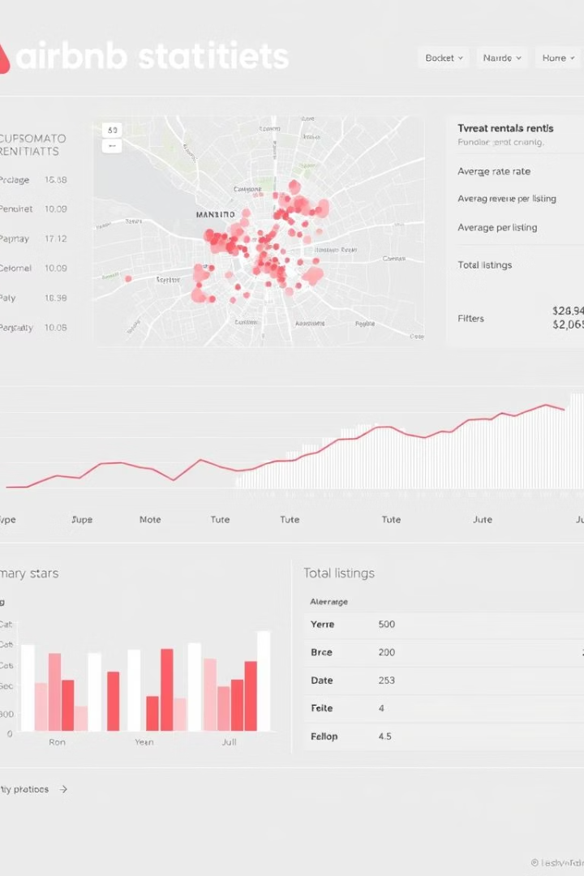
Market Overview
6,542
Total Listings
Across both cities
$146
Average Price
Per night across both markets
$152
Chicago Average
Slightly higher than overall average
$137
New Orleans Average
More affordable option

Slide 3
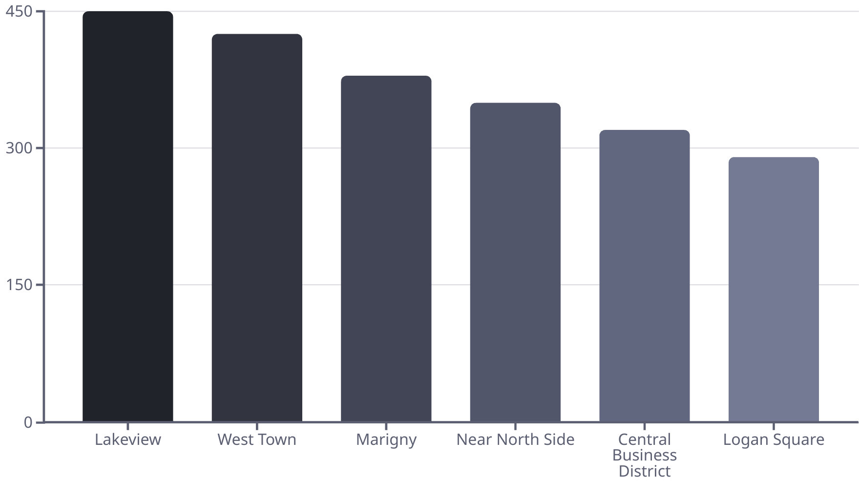
Geographical Distribution

Slide 4






Room Type Analysis
Private Room
25% of listings
Average: $73/night
Entire Home/Apt
Shared Room
72% of listings
3% of listings
Average: $178/night
Lowest price point

Slide 5
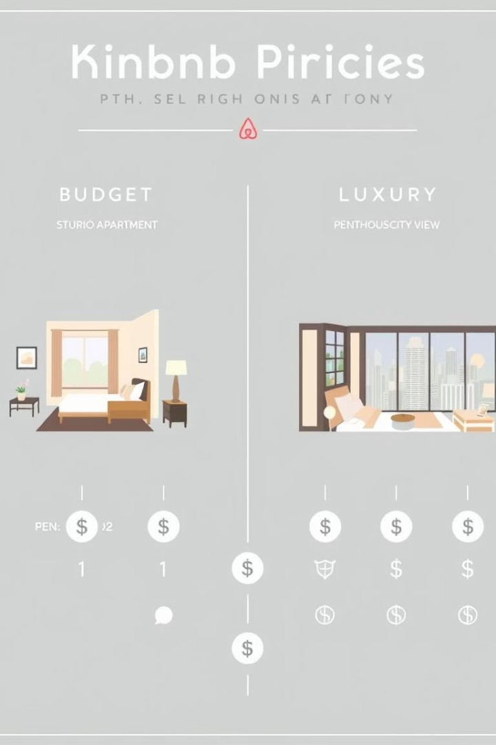




Price Distribution
Budget
Under $100/night
Mostly private rooms
Mid-Range
$100-$200/night
80% of all listings
Luxury
$200-$500/night
Premium locations
Ultra-Luxury
$500+/night
Rare specialty listings

Slide 6

Review and Guest Experience
Overall Satisfaction
Value Insight
Average review score: 4.63/5
Highest-rated listings (>4.8) average $110-$130/night
Chicago: 4.66/5
New Orleans: 4.59/5
Good service doesn't always mean premium pricing
Top Neighborhoods
Bywater and Logan Square have highest ratings
Indicates quality stays and vibrant host activity

Slide 7
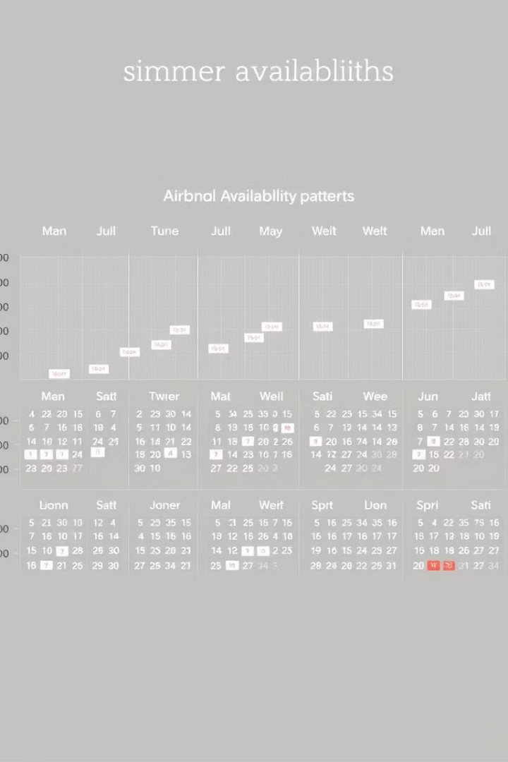




Availability & Seasonal Trends
Year-Round
Most listings available 200+ days/year, especially in Chicago
Summer Peak
Highest activity June-August in both cities
Pricing Strategy
High-availability listings priced 10-15% lower
Part-Time Hosting
Listings with <100 days availability often belong to casual hosts

Slide 8






Host Dynamics & Conclusions
Market Insights
Chicago dominates in quantity, New Orleans in affordability
Host Distribution
45% manage one listing; top 10% control 35% of market
Value Finding
High reviews not limited to high prices

